Slide 1
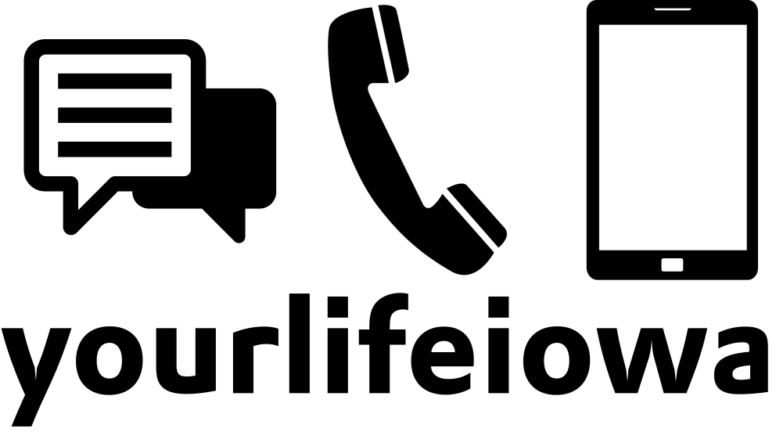
Iowa’s Statewide Youth Suicide/Bullying Prevention Crisis Services
Beau Pinkham
Crisis Intervention Services Director
The Crisis Center of Johnson County

Slide 2
The Services
Phone line
Chat
Text
Outreach

Slide 3
Wait, What’s Crisis Intervention?
Short-term counseling
Referral/action-planning
Suicide prevention
Follow-up/motivational contacts

Slide 4
Phone Line
395 calls in FY16
Mostly out-of-state adults
SURPRISE: KIDS HATE PHONE CALLS
Reasons that youth call in – physical health help, pranks

Slide 5
Chat
1078 “engaged” chats in FY16 (1682 received)
Much more likely to be Iowa youth! Specifically, females age 14-17
Wide variety of topics – NSSI, school, suicide thoughts, relationships (SO MANY RELATIONSHIPS), LGBTQ issues, etc.

Slide 6
Text
114 “engaged” texts in FY16 (150 received)
Small but growing (FY17 stats are well beyond this already)
Eclectic mix – Iowa youth, Iowa adults, etc.
Topics are all over the place
Text as service is still finding its voice in crisis intervention world
Tough on CI side of things to deal with

Slide 7
So where do we go from here?
Continue to advertise and expand services
Encourage growth in Iowa
Constantly vigilant on new trends – counseling via social media, etc.
yourlifeiowa.org
Questions? Contact me at:
beau.pinkham@jccrisiscenter.org

