Slide 1
Prior-Prior Year: Financial Aid Changes You Need to Know
Erick Danielson, Iowa College Access Network

Slide 2
A Change is Coming
Lots of talk over the last few years:
Simplify the financial aid process
Simplify the FAFSA
Eliminate the FAFSA
Change federal loan programs
After lots of debate, change is here.
Notes:
With an ICAN Student Success Center closer to your community, we encourage you to take advantage of our full services. Call to setup a one-on-one advising session. Myself or one of my team members will be happy to sit down and go over a more individualized plan for your future. And these advising sessions are free.

Slide 3
Change is Here
Before | Now
PIN Numbers | FSA ID
FAFSA available Jan. 1 | FAFSA available Oct. 1
FAFSA Priority Deadlines: Jan 1 – April 15 | TBD
Taxes – Use current year | Prior-Prior Year
Notes:
With an ICAN Student Success Center closer to your community, we encourage you to take advantage of our full services. Call to setup a one-on-one advising session. Myself or one of my team members will be happy to sit down and go over a more individualized plan for your future. And these advising sessions are free.

Slide 4
Change is Here
Federal Student Aid ID
Earlier FAFSA Filing Date
Priority Deadlines
College & University planning
Overall financial aid timeline changes
Overall college planning timeline changes
ICAN changes
Notes:
With an ICAN Student Success Center closer to your community, we encourage you to take advantage of our full services. Call to setup a one-on-one advising session. Myself or one of my team members will be happy to sit down and go over a more individualized plan for your future. And these advising sessions are free.

Slide 5
Goodbye PIN. Hello FSA ID.
PIN number – traditional login and signature for FAFSA
May 2015 – Replaced with FSA ID

Slide 6
Federal Student Aid (FSA) ID
What is an FSA ID?
Username and password
How is the FSA ID used?
Used to login to certain websites. Also confirms a student/parent’s identity when accessing online financial aid information and electronically signing documents
How do students get an FSA ID?
www.ICANsucceed.org/fsaid provides steps and guidance
Notes:
Read slide

Slide 7
Federal Student Aid (FSA) ID
What websites will utilize the FSA ID?
www.FAFSA.gov
The National Student Loan Data System (NSDLS)
www.nslds.ed.gov
www.Studentloans.gov
www.StudentAid.gov
Agreement to Serve (ATS) – www.teach-ats.ed.gov
Notes:
Read slide

Slide 8
Federal Student Aid (FSA) ID
Steps to Create an FSA ID
Visit www.fsaid.ed.gov
Create username and password – enter e-mail address
Enter name, birthdate, Social Security number, contact information
Select five challenge questions and answers
If you have PIN number, link the PIN to FSA ID for verification
Confirm email address using secure code
Important Tips
Takes about 15 minutes to setup each ID
Students and parents need IDs – will need separate email addresses
Don’t use school email address
Write EVERYTHING down
Notes:
Read slide

Slide 9
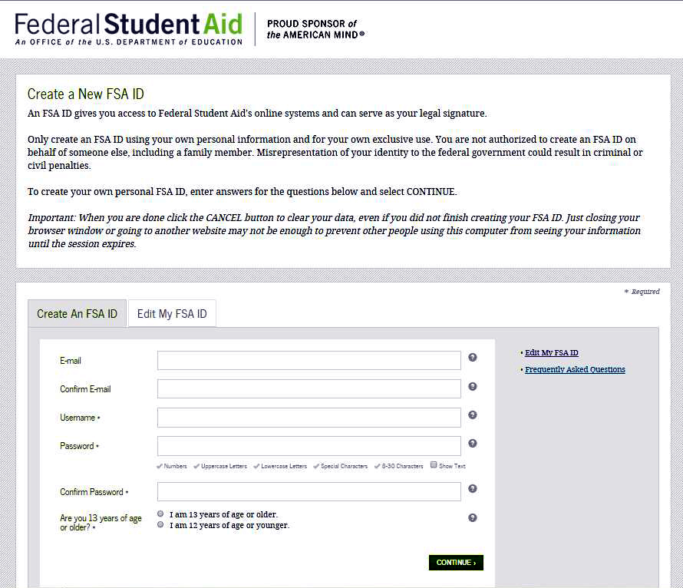
Notes:
Read slide

Slide 10
Earlier FAFSA Filing Date
President Obama announced on September 14, 2015 – North High School – Des Moines
Initiative to allow students and families to apply for financial aid earlier
Notes:
Read slide

Slide 11
Earlier FAFSA Filing Date
Starting with the 17-18 FAFSA, students can begin filing on Oct. 1, 2016 (Three months earlier than normal)
Instead of Prior Year taxes, will begin using Prior-Prior Year (PPY)
Notes:
Discuss different options after high school and briefly what it takes to enter those areas.
Workforce – competent skills in communications, maybe math and science as well – people skills, interview skills.
Training program – varies – competent skills in communications, maybe math and science as well.
Apprenticeship – competence and basic skills
Military – pass entrance exams – healthy and fit – boot camp
College – course planning, testing and admission process along with financial aid

Slide 12
Priority Deadlines
Will schools move up their deadlines?
Will it be different for new students compared to returning students?

Slide 13
College & University Planning
Setting Tuition & Fees
Software
Funding Levels – Federal & State

Slide 14
Overall Financial Aid Timeline
Still lots of questions to be answered
Award Letters going out earlier?
Hope is to give families more time in making a decision

Slide 15
Overall College Planning Timeline
Not supposed to change
Financial Aid is now to align more with College Planning Process
Not to pressure them to make earlier decisions

Slide 16
ICAN Changes
Aug-Oct - Freshman Transition, Career & College Planning and Financial Aid Nights
No Presentations from Middle of Nov-Jan
Start back up in Feb-May with all our presentations

